Slide 1
Overview
For: company name

Slide 2

aswf.io

Slide 3
Why Open Source?

Slide 4
Why Open Source?
Software development has a cost
Development
Maintenance
Documentation
Training
Open Source ecosystems share those costs
Empower developers to lead development
Notes:
Why open source? Because software development has a cost, no matter if it is proprietary, commercially available or free. Open Source software shares some of those costs between multiple companies and contributors.

Slide 5

































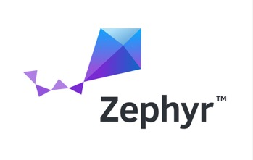

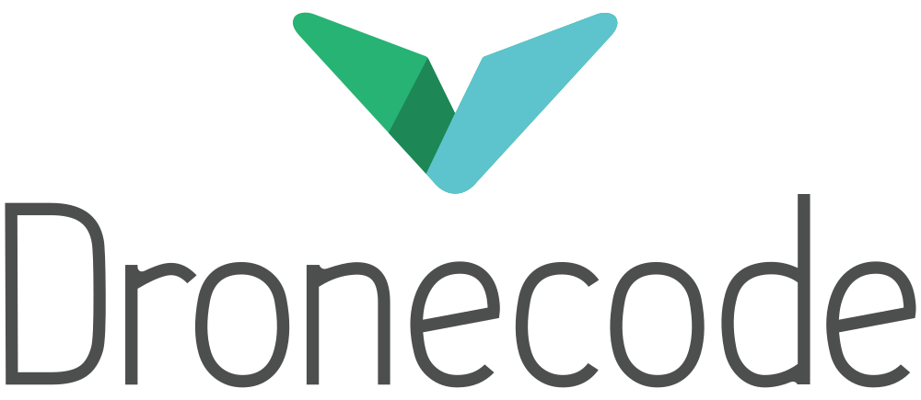


































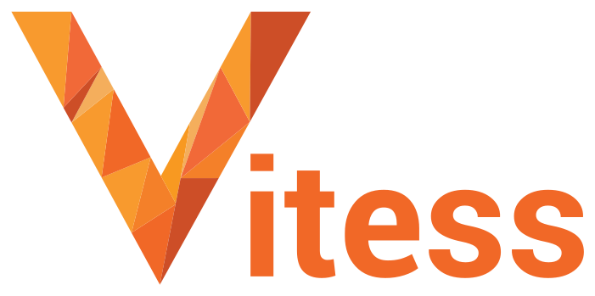
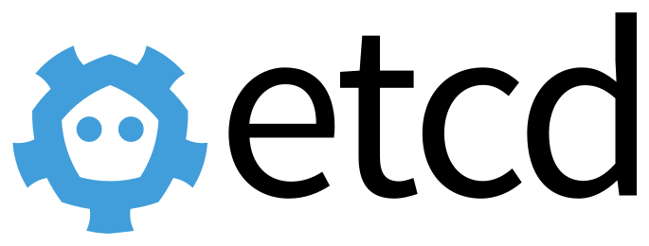












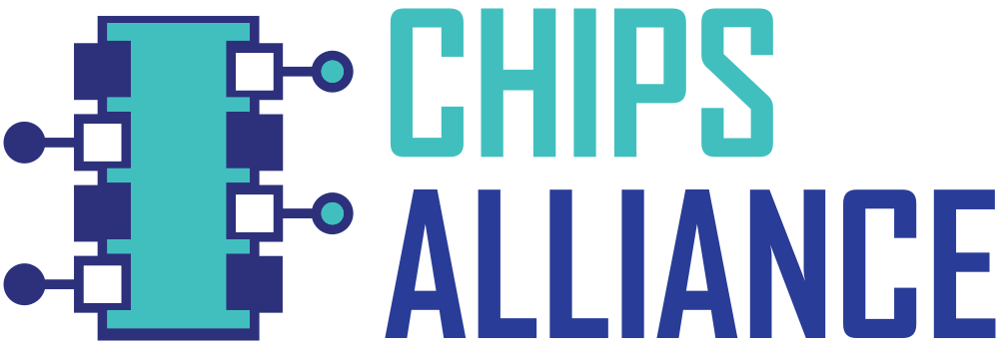








Open Source Projects
Security
Networking
Cloud
Automotive
Blockchain
Edge/IoT
Web
AI
Film
CI/CD
Energy
Hardware
Standards
Notes:
Over time, communities of open source software developers have grown around hundreds of projects in all industries, and categories from hardware to standards, from Energy to Blockchain from Security to AI to Cloud computing.

Slide 6
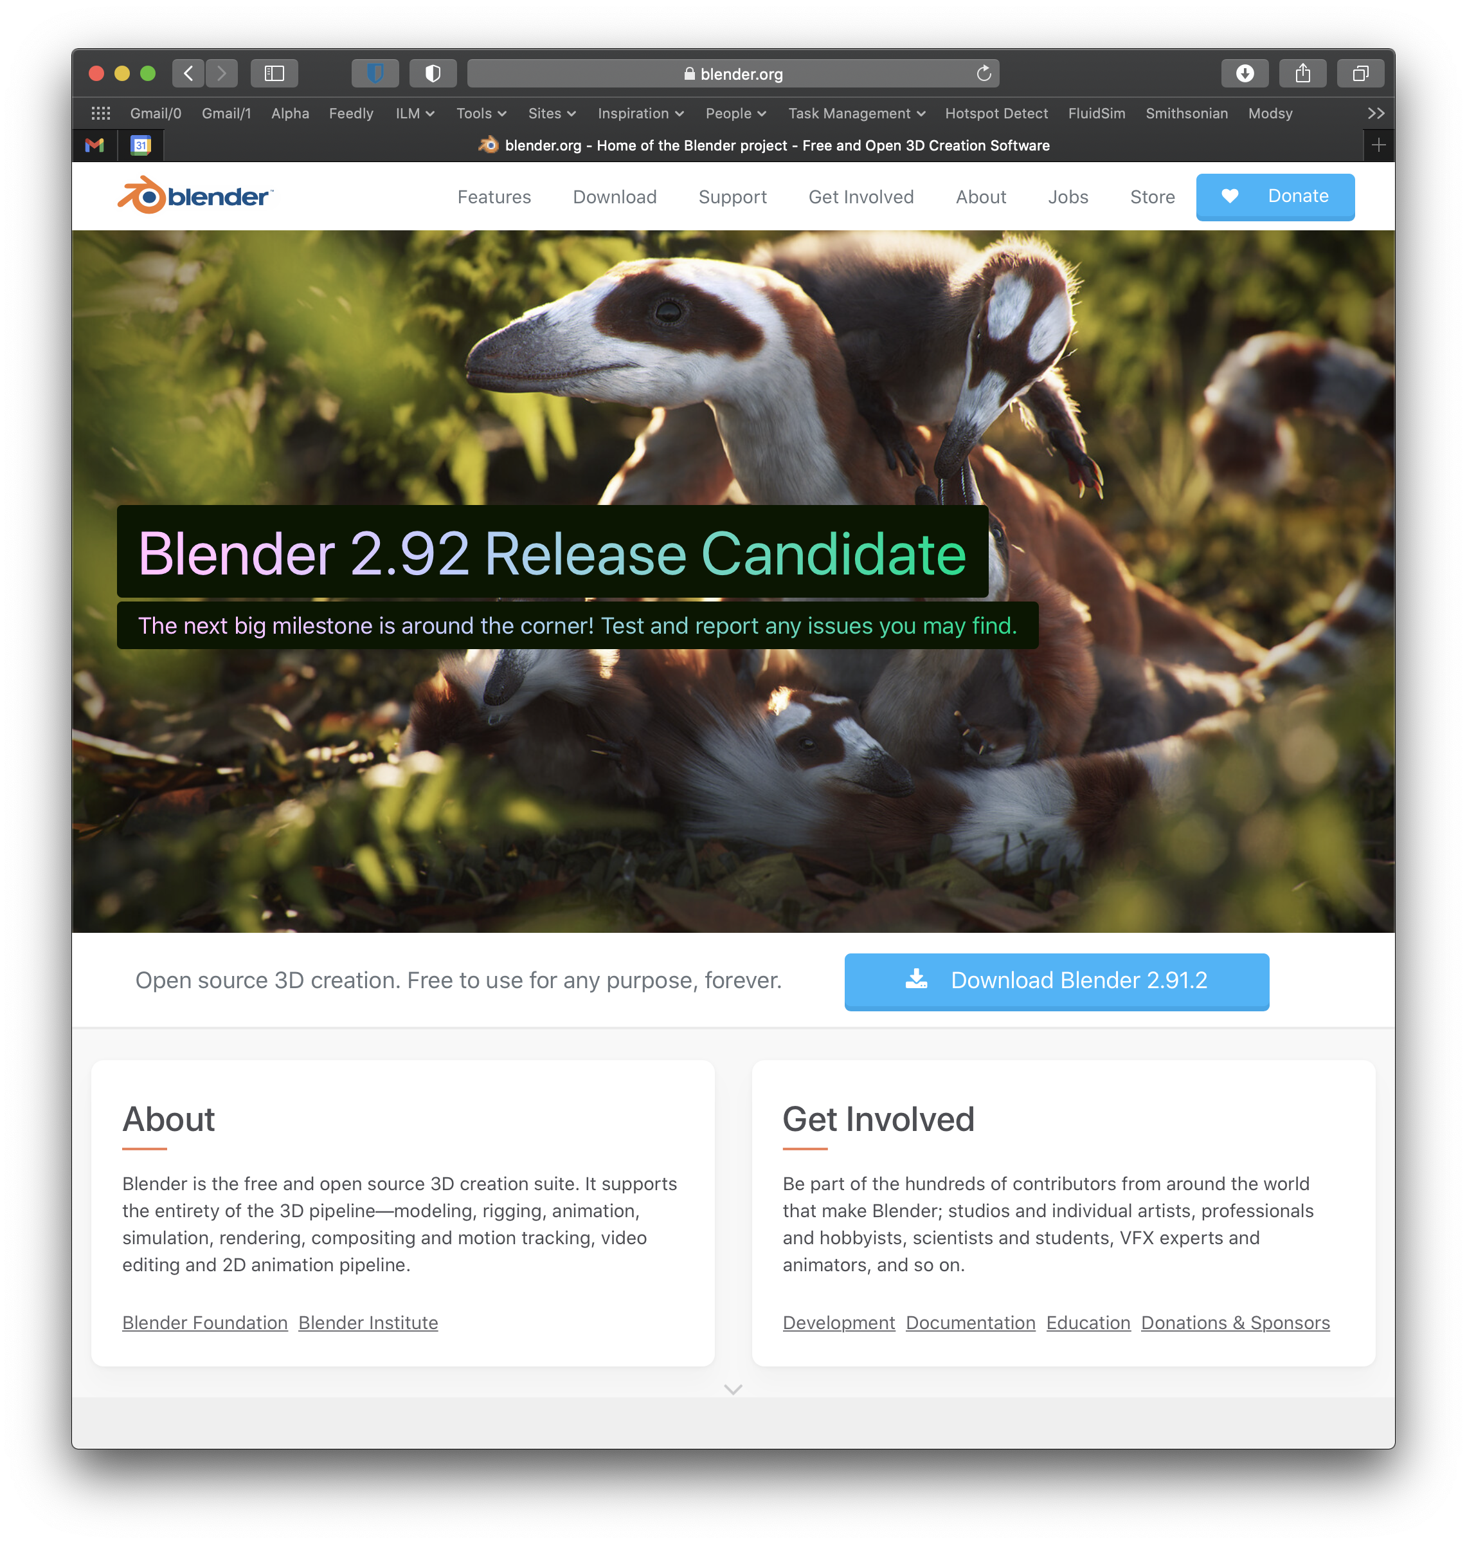
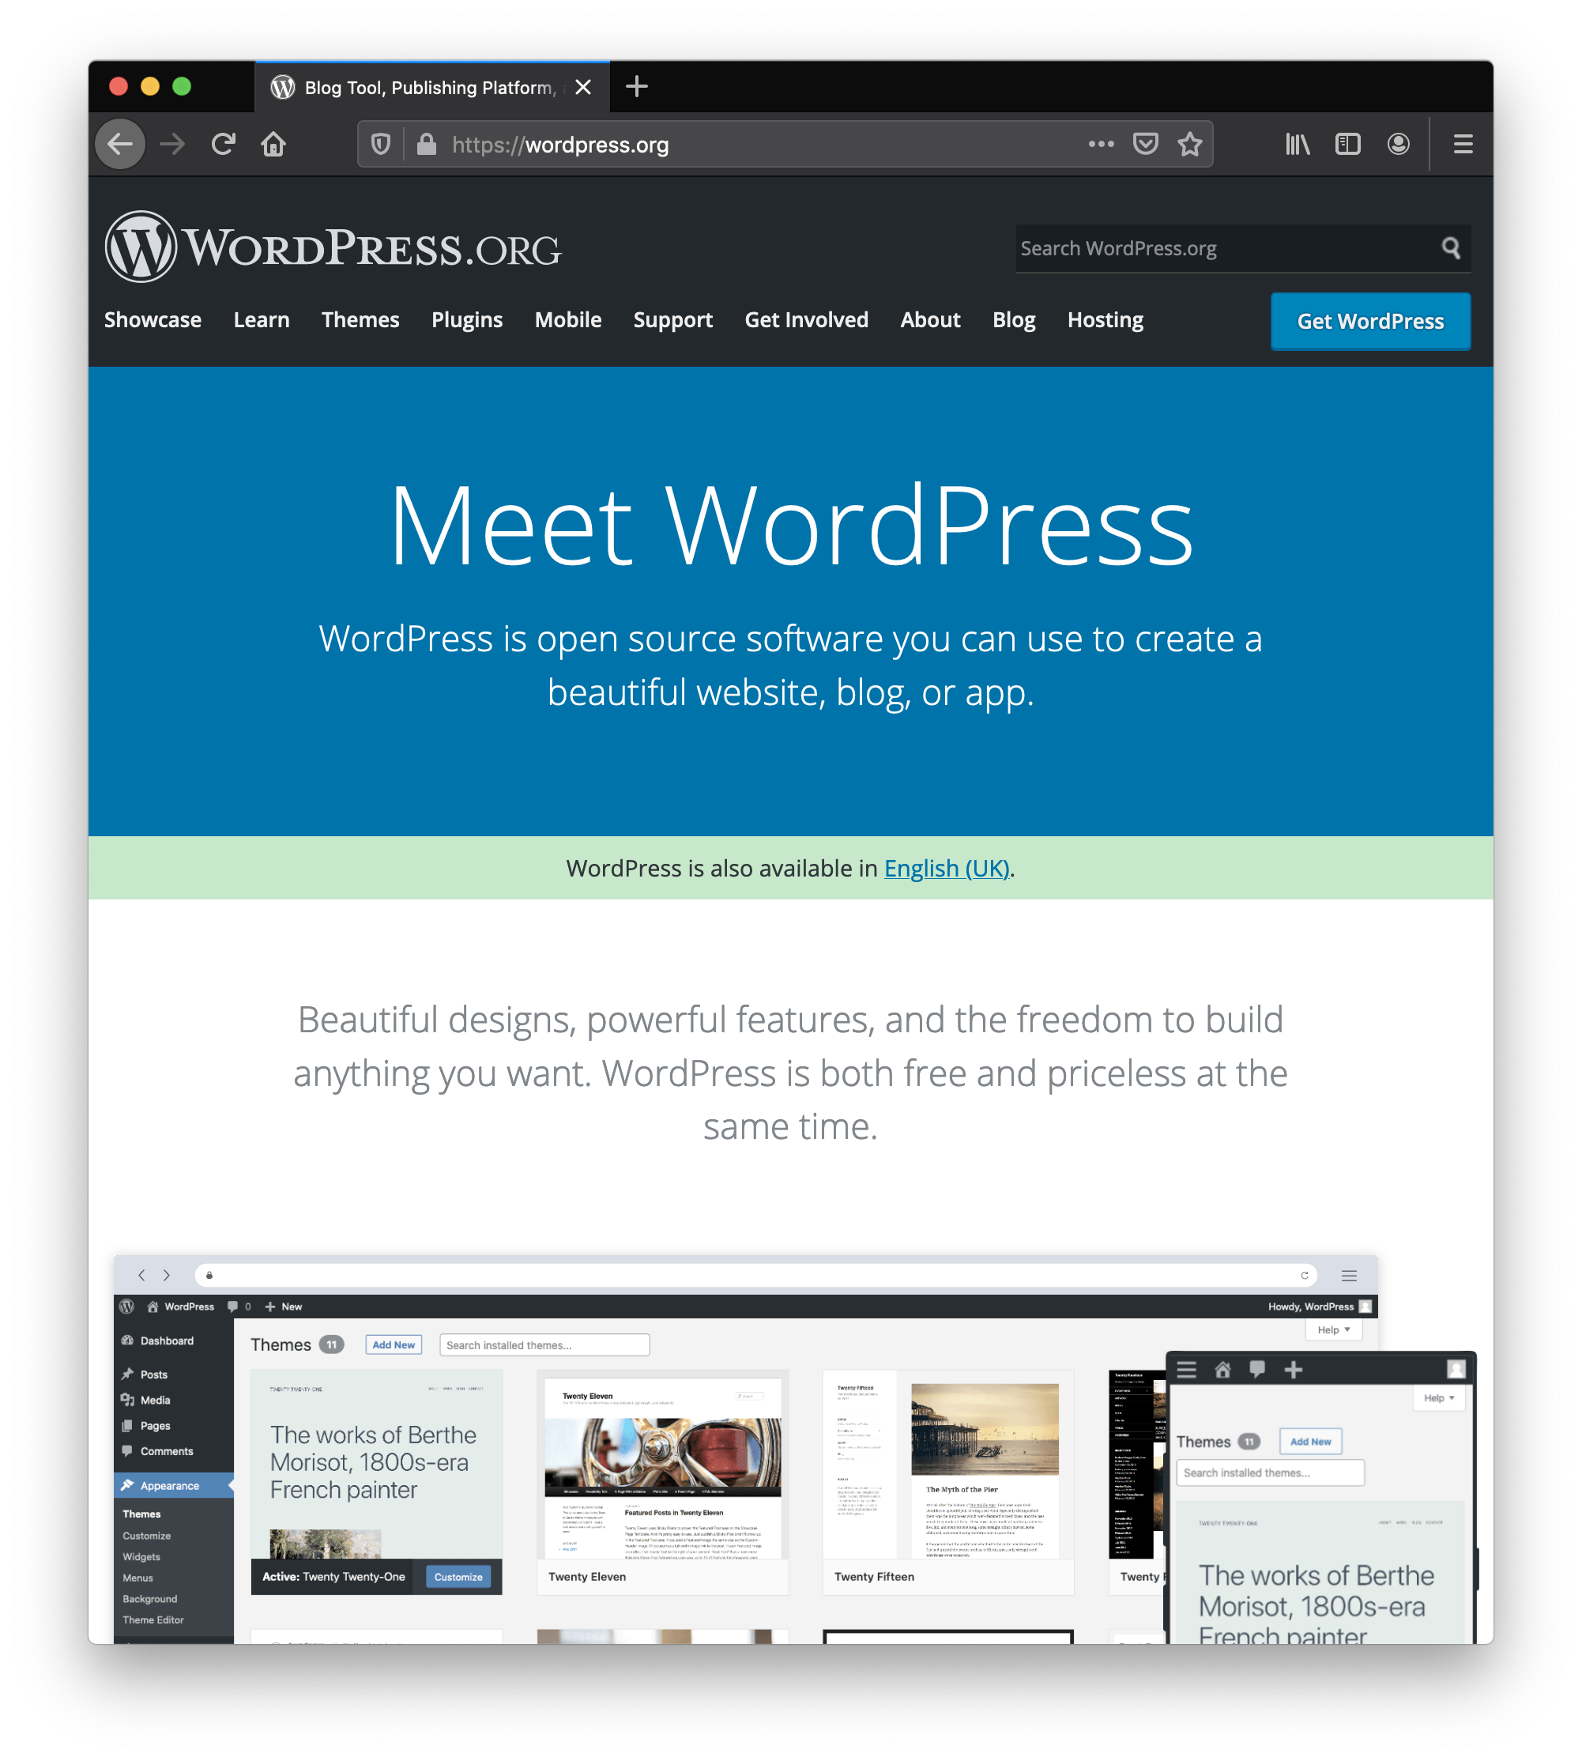
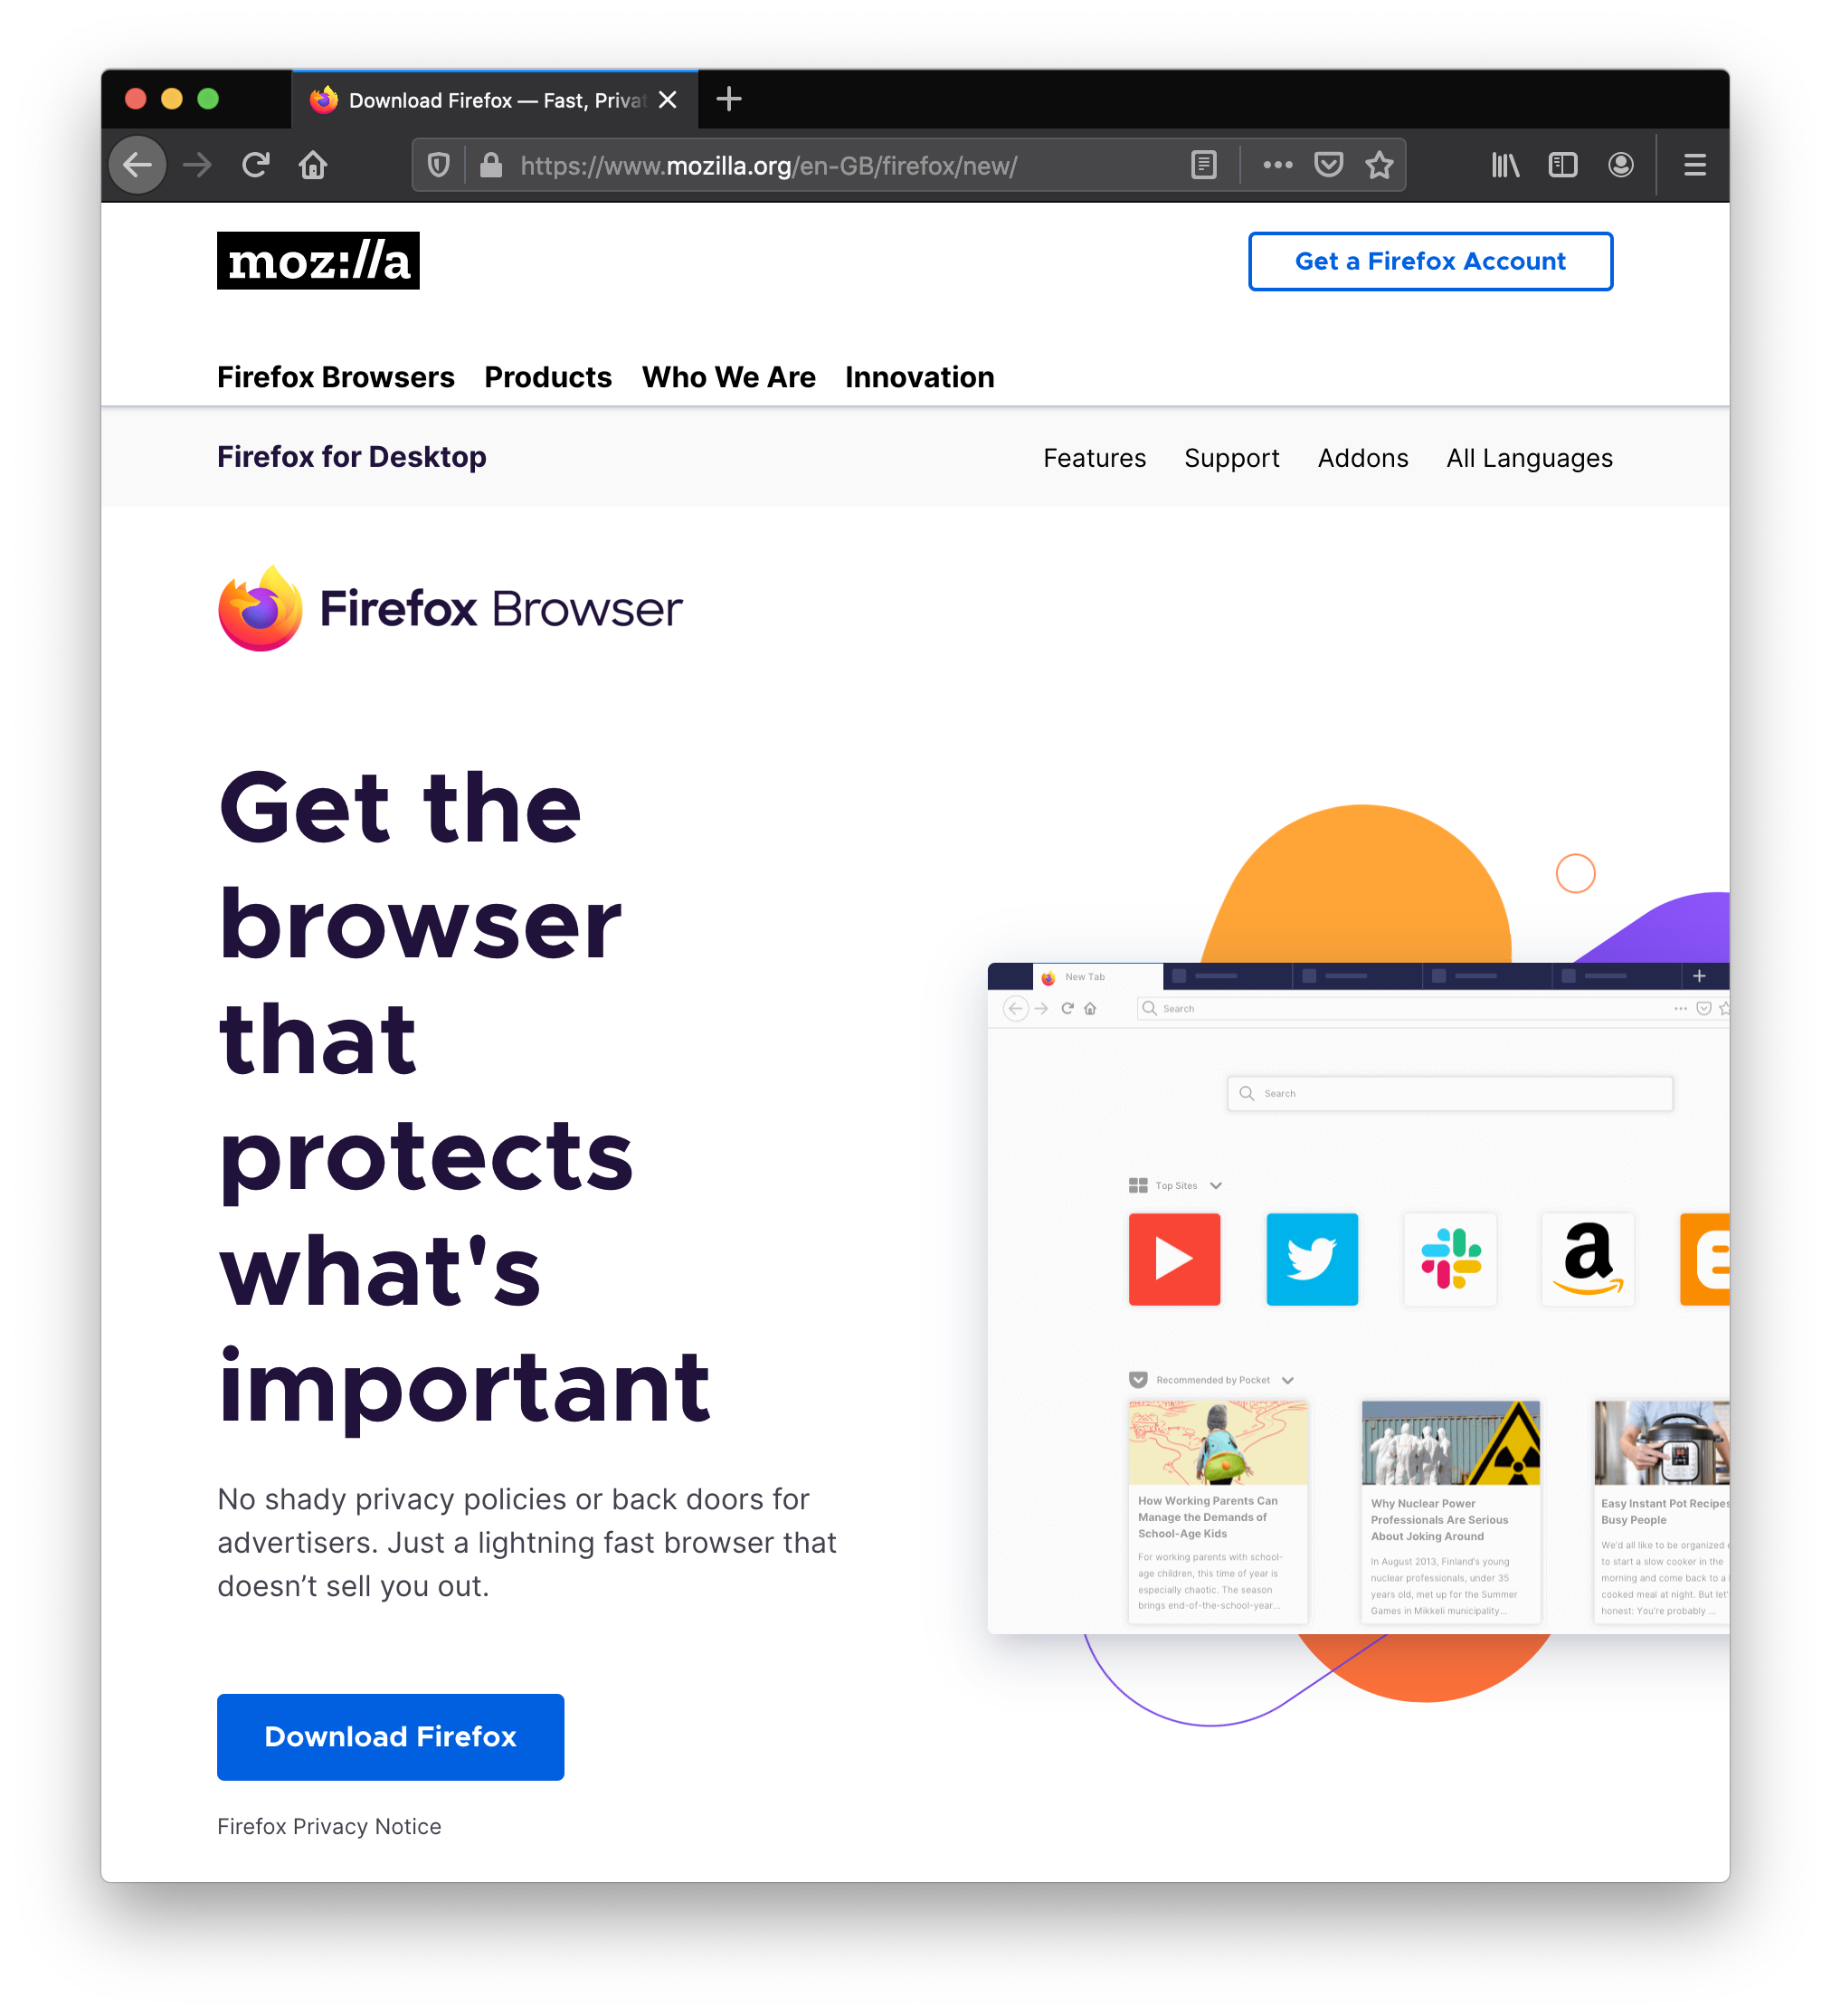
Notes:
And it’s not just libraries and developers tools. Firefox, Blender, Wordpress for instance are great example of end user tools that have a vibrant open source community around them.

Slide 7
Open Source: Innovation Accelerator
Neutral environment for collaboration & cross-pollination
Standardization on open technologies
Innovation multiplier
Enables better interoperability
Minimizes fragmentation
Qualifies reference architectures
Lowers barriers to enter a new domain
Enables new business opportunities
Leads to better products
Allows shared cost of development
Notes:
Open source can really be an enabler for all these things.

Slide 8
About the Academy Software Foundation
Notes:
In that context, why the ASWF, and more particularly what benefits was it set out to bring to the Film industry?

Slide 9


An Open Source Foundation Developed in Partnership
The Academy Software Foundation provides a neutral forum for open source software developers in the motion picture and broader media industries to share resources and collaborate on technologies for image creation, visual effects, animation and sound.
Notes:
The Academy Software Foundation was developed in a partnership between the Academy of Motion Picture Arts and Sciences and the Linux Foundation, both partners bringing a unique blend of film industry knowledge and open source technical and organizational expertise to create a unique organization dedicated to accelerate software development and innovation in the motion picture industry.

Slide 10

Why the Academy Software Foundation?
Legal Framework
Continuous Integration and Build Infrastructure
Clear path to accepting contributions (neutral forum)
Versionitis
Notes:
These were some of the problems that the Foundation set out to solve.

Slide 11


ASWF created
01
Open Source Days 3
Open
Source
Forum
Open Source Day 1
Open Source Days 2
August 10, 2018
Founding members:
Animal Logic
Autodesk
Blue Sky Studios
Cisco
DNEG
DreamWorks Animation
Epic Games
Foundry
Google Cloud
Intel
SideFX
The Walt Disney Studios
Weta Digital
First project
August 4-5, 2021
MaterialX
Maxon
March 10,2022
Rez
DPEL
RawtoACES
July 29, 2019
OpenTimelineIO
Netflix
Amazon Web Services
Rodeo FX
MovieLabs
August 19-20, 2020
Unity Technologies
Conductor Technologies
SMPTE
October 23,2018
OpenVDB
New members:
Sony Pictures Entertainment
Warner Bros.
Blender Foundation
Visual Effects Society
10
12
April 16, 2020
Open Shading
Language
AMD
DockYard
September 13, 2019
Apple
Microsoft
08
05
December 15,
2020
Adobe
ETC
January 28,
2022
WEVR
02
February 8, 2019
OpenColorIO
06
03
May 1, 2019
OpenEXR
OpenCue
NVIDIA
ftrack
Red Hat
07
09
11
Scitech
Council
COVID
19
Open source
Investigation
concludes
04
$1M/year
May
August
Nov
Feb
May
August
Nov
Feb
May
August
Nov
Feb
August
Jan
March
2018
2019
2020
2021
2022
Notes:
The Academy Software Foundation timeline of notable events since its creation 3 years ago.

Slide 12












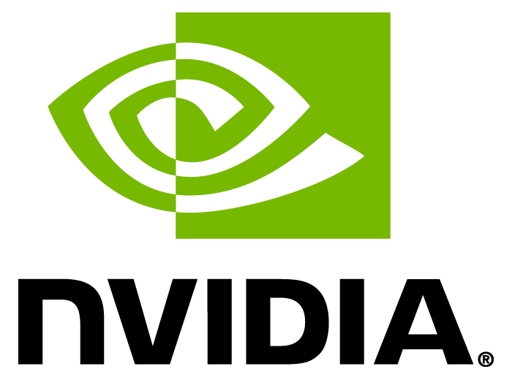


















Membership
Premier Members
General Members
Associate Members
Notes:
The Foundation now has 30 members in three categories. We want to thank all the companies listed here for their active participation in our goals and mission – and if you don’t see your company listed here, you may want to consider joining if you are interested in our good cause.

Slide 13
Our Mission
Increase the quality and quantity of open source contributions by establishing a governance model, a legal framework and a community infrastructure that lowers the barrier to entry for developing and using open source software.

Slide 14
Our Goals
Provide a neutral forum to coordinate cross-project efforts, establish best practices and share resources.
Develop an open continuous integration (CI) and build infrastructure to enable reference builds from the community.
Streamline development for build and runtime environments through the sharing of open source build configurations, scripts and recipes.
Provide individuals and organizations with a clear path for participation and code contribution.
Provide better, more consistent licensing through a shared licensing template.
Create working groups for exploration of new or larger projects.
Focus on diversity and inclusion and raising the profile of software engineers in our industry.

Slide 15










Structure
TAC
Technical Advisory Council
Governing Board
Outreach Committee
OpenVDB
OpenColorIO
OpenCue
OpenTimelineIO
OpenEXR
Open Shading Language
MaterialX
rawtoACES
Digital Production
Example Library
Continuous Integration platform

Slide 16
Diversity & Inclusion
Diversity & Inclusion Working Group
“Open source has the power to break down racial, gender, and corporate barriers to unite people around a shared goal…”
Read more at aswf.io/diversity_inclusion.

Slide 17
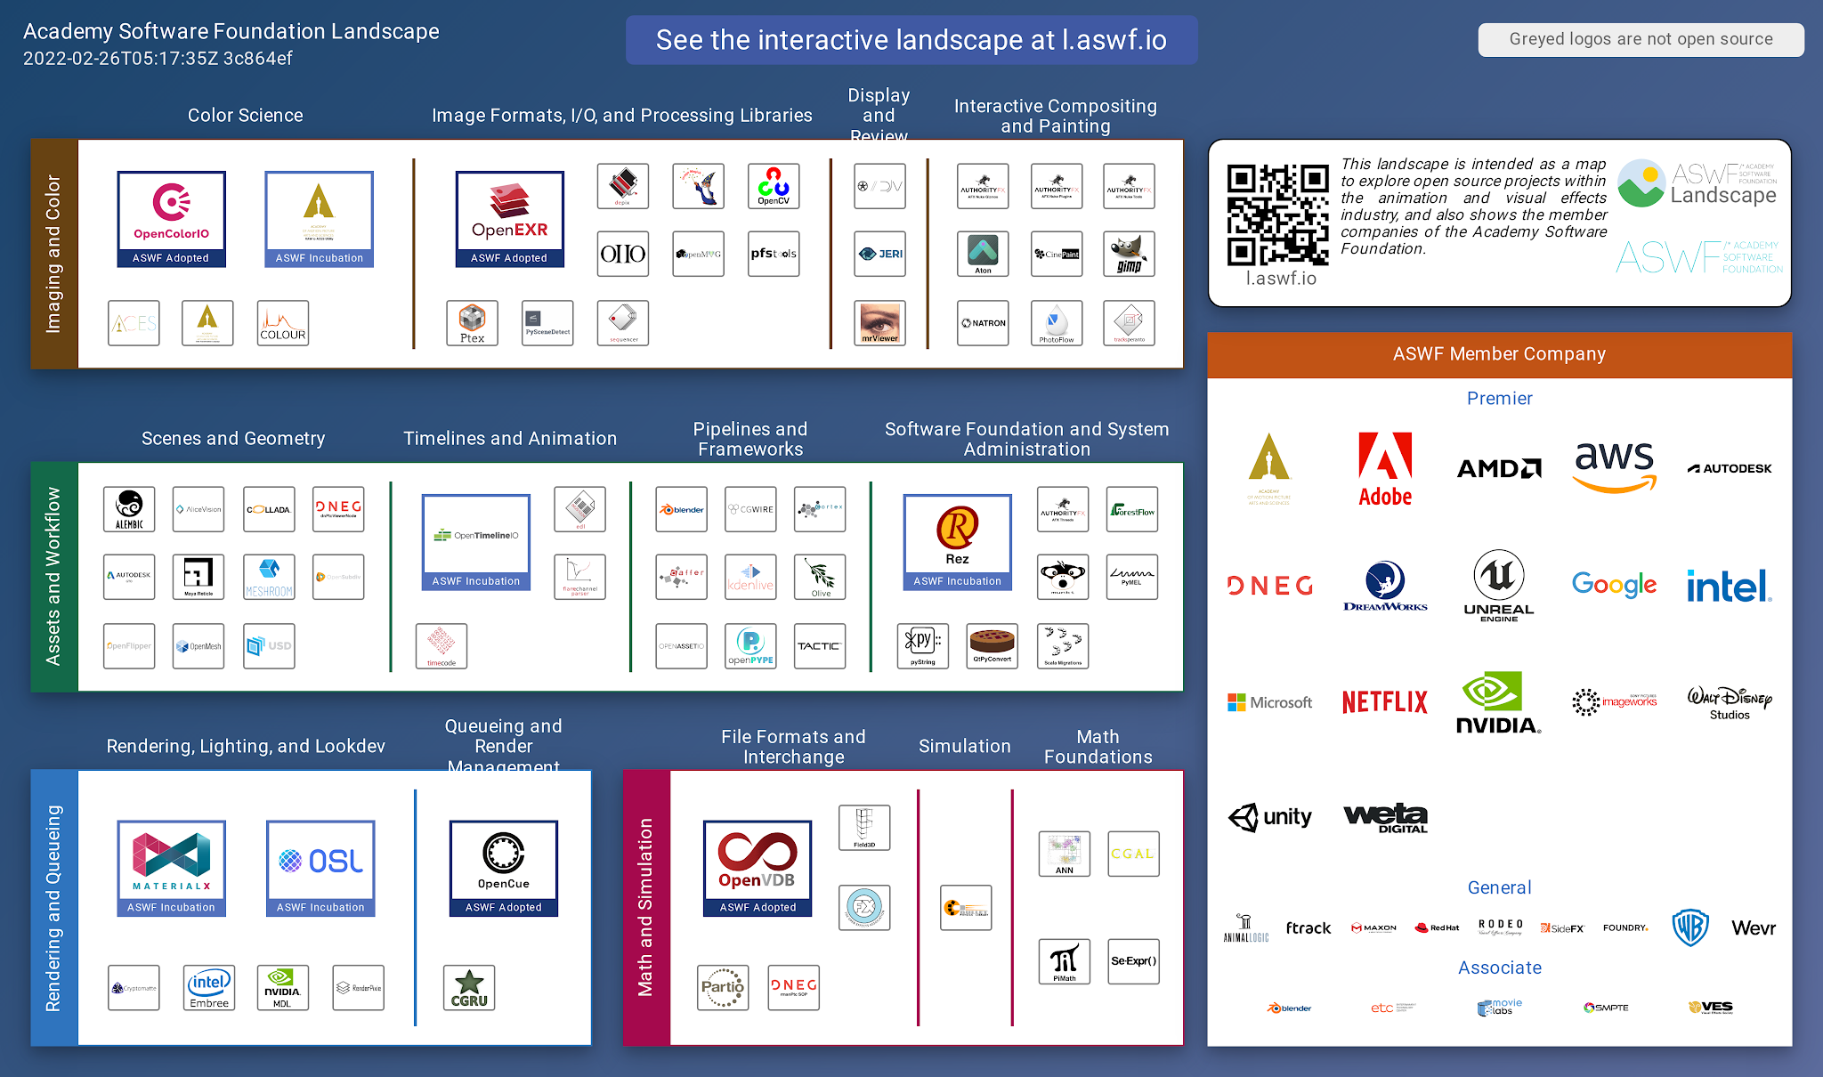
ASWF Landscape
https://l.aswf.io/
Public list of open source projects in the animation and VFX industry
Updates can be submitted via GitHub
Goal is to have all active, open source projects in animation and VFX industries represented.

Slide 18





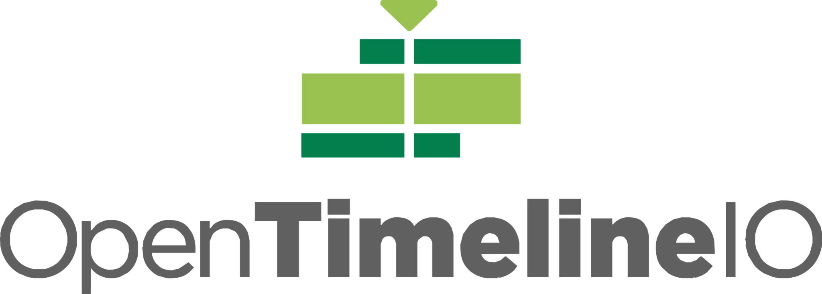
Our Projects
contributed by:
Dreamworks Animation
contributed by:
Sony Pictures Imageworks
contributed by: Google Cloud and
Sony Pictures Imageworks
contributed by:
Academy Software Foundation
contributed by:
The Academy of Motion Picture Arts and Sciences
contributed by:
Lucasfilm
contributed by:
Pixar Animation Studios
contributed by:
Sony Pictures Imageworks
contributed by:
Lucasfilm
contributed by:
Academy Software Foundation

Slide 19



How to Train Your Dragon: The Hidden World; courtesy of DreamWorks Animation
The Croods; courtesy of DreamWorks Animation
First project adopted by ASWF in Sept. 2018; first project to graduate to adopted status in July 2019.
Developed by DreamWorks Animation in 2012.
C++ library for volumetric representations including fluid simulations, animated volumes and environmental effects.
Academy Technical Achievement Award recipient.
Key contributors include DreamWorks, Autodesk, DNEG, Industrial Light & Magic, NVIDIA, SideFX, Weta Digital.
github.com/AcademySoftwareFoundation/openvdb
Notes:
Used on films including Boss Baby, Trolls, The Croods, and How to Train Your Dragon: The Hidden World
Since joining:
Released v6.0, v6.1, v7.0 (above + bug-fixes & optimizations)
New collaborations (Autodesk/Nvidia)

Slide 20
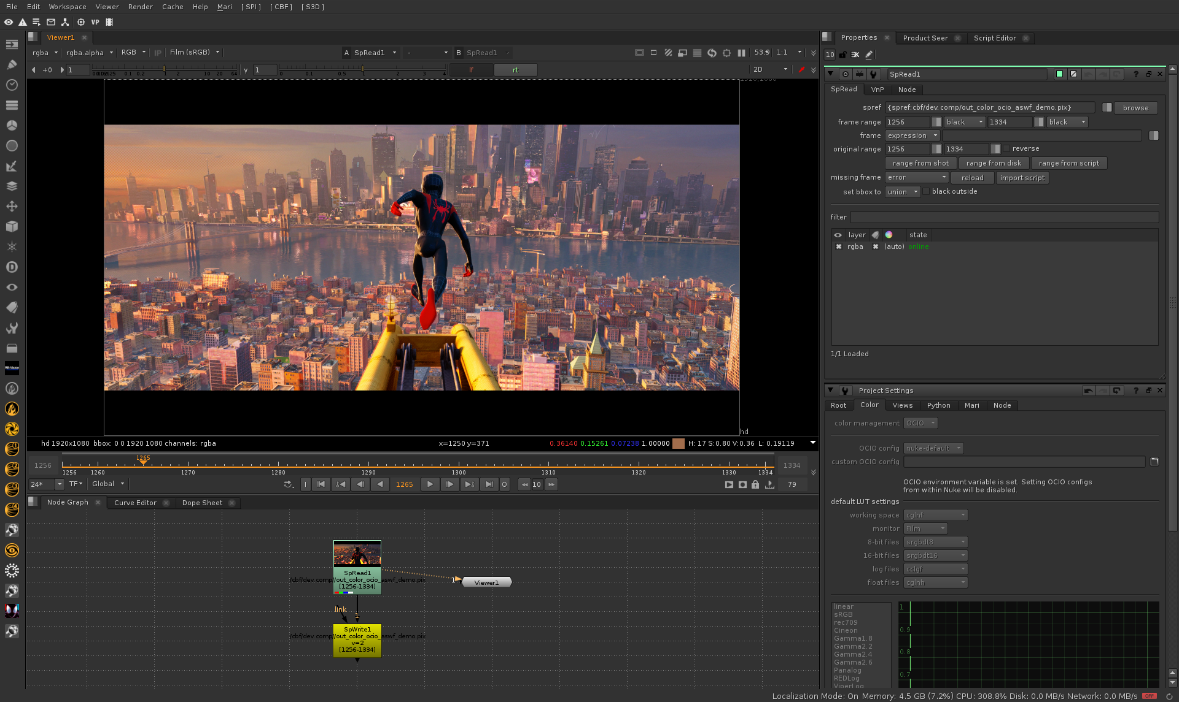
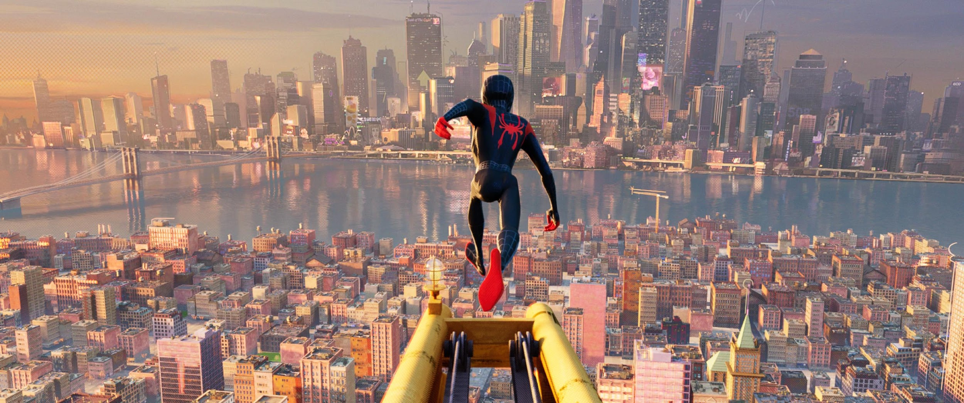
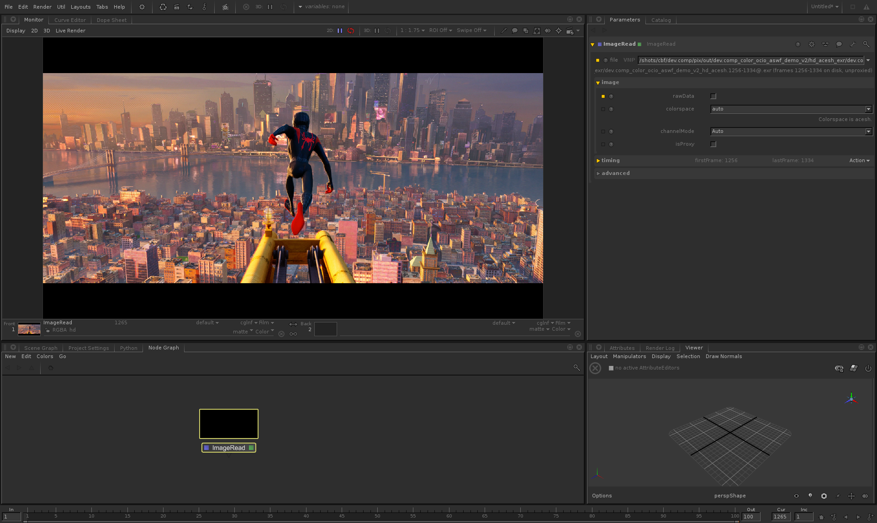
Nuke
Spider-Man™: Into the Spider-Verse; all images courtesy of Imageworks
Joined ASWF in Feb. 2019; adopted status in Nov. 2019.
Developed by Sony Pictures Imageworks in 2003.
Provides a consistent user experience across digital content creation applications; widely adopted in VFX and computer animation studios and software.
Academy Technical Achievement Award recipient.
Key contributors include Imageworks, Autodesk, DNEG, ILM, Foundry, Framestore.
OCIO v2 released fall 2020, led by Autodesk.
Katana
github.com/AcademySoftwareFoundation/OpenColorIO
Notes:
Top image is in Foundry’s Nuke, bottom in Foundry’s Katana

Slide 21

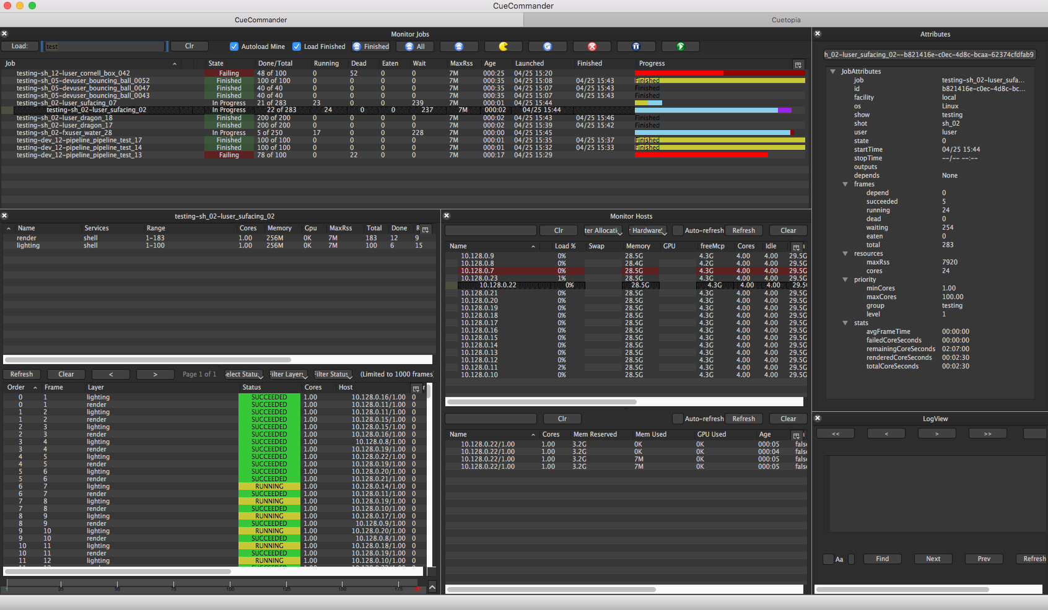
Smurfs: The Lost Village; courtesy of Sony Pictures Imageworks
OpenCue screenshot
Joined ASWF in April 2019.
Developed at Sony Pictures Imageworks as its internal render farm manager (“Cue3”); collaboration with Google Cloud to release as OpenCue in January 2019.
Fully featured render manager for media and entertainment that can be used to break down complex jobs into individual tasks.
Contributors include Imageworks, Google, Netflix, Microsoft, Amazon.
Monthly releases over the past year, including adding Python 3 compatibility, Windows support, new documentation.
github.com/AcademySoftwareFoundation/OpenCue

Slide 22
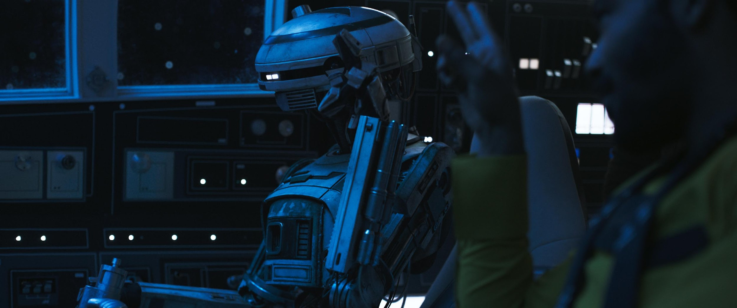

Images from Solo: A Star Wars Story. © and TM Lucasfilm Ltd. All Rights Reserved.
Joined ASWF in April 2019; adopted status in Nov. 2019.
Developed by ILM in 1999; first release of a major open source project by a studio.
High dynamic-range (HDR) image file format for high-quality image processing and storage; widely adopted standard in computer graphics.
Academy Technical Achievement Award recipient.
Key contributors include ILM, Disney Animation, Imageworks, Epic Games, Weta Digital, Pixar, Autodesk, and DreamWorks.
OpenEXR 3.0 just released.
github.com/AcademySoftwareFoundation/OpenEXR

Slide 23
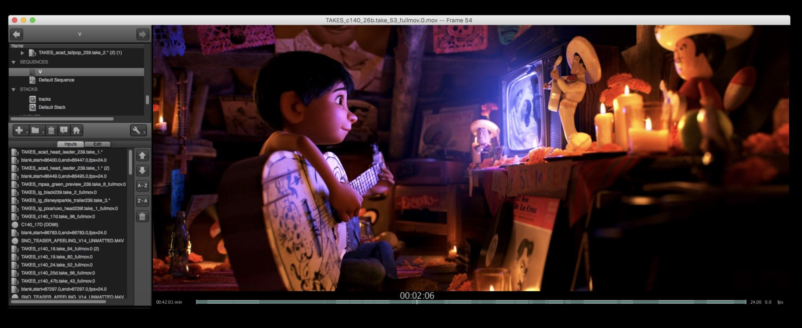
OpenTimelineIO used on Coco for transitions and linking media to the latest renders.
Image courtesy of Pixar Animation Studios.
Joined ASWF in July 2019.
Developed by Pixar Animation Studios.
Open source interchange format for editorial timeline information – clips, timing, tracks, transitions, metadata etc.
Key contributors include Pixar, Netflix, DreamWorks, Autodesk.
In Public Beta
github.com/PixarAnimationStudios/OpenTimelineIO

Slide 24


The Angry Birds Movie 2; courtesy of Imageworks
Spider-Man: Far From Home; courtesy of Imageworks
Joined ASWF in April 2020.
Developed by Sony Pictures Imageworks; released as open source in 2010.
De facto standard shading language for VFX and animation, ideal for describing materials, lights, displacement, and pattern generation.
Academy Technical Achievement Award recipient.
Key contributors include Imageworks, Animal Logic, NVIDIA, Pixar, DNEG, Autodesk.
github.com/Imageworks/OpenShadingLanguage

Slide 25
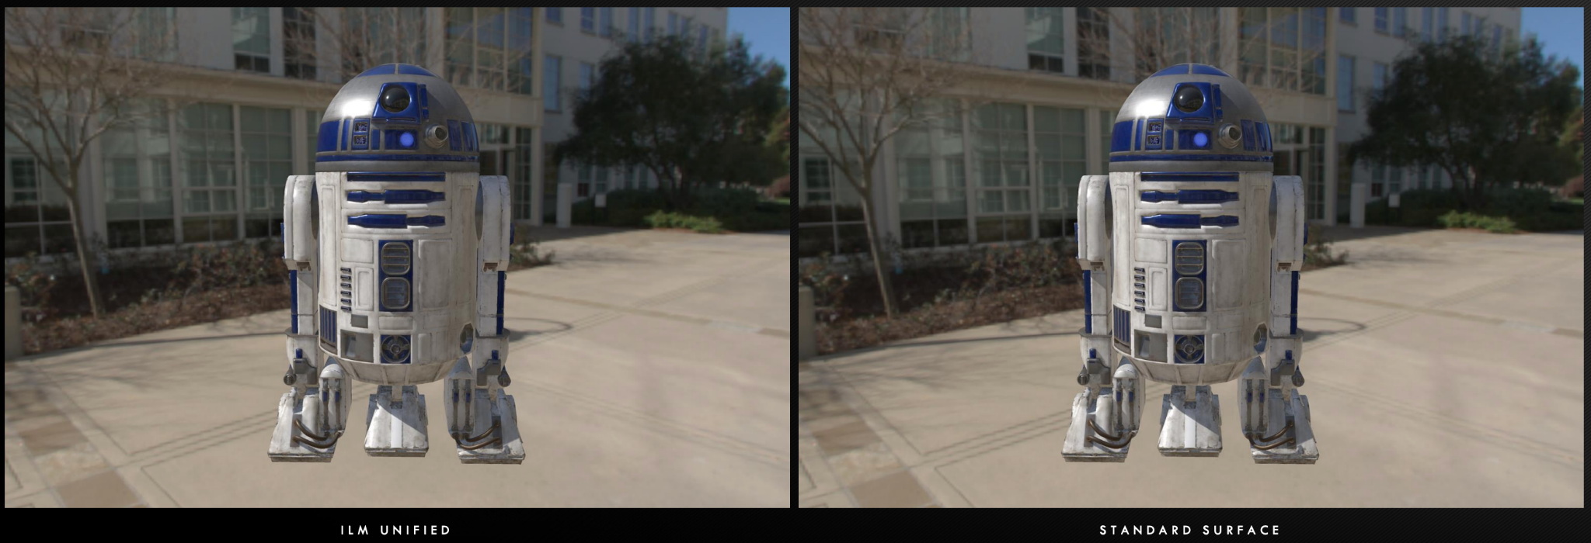
ILM Production tests using MaterialX
Joined ASWF in March 2021.
Open standard for representing rich material and look-development content in computer graphics, enabling its platform-independent description and exchange across applications and renderers.
Launched at Industrial Light & Magic in 2012, MaterialX has been a key technology in their feature films and real-time experiences since Star Wars: The Force Awakens and Millennium Falcon: Smugglers Run.
Key contributors include Sony Pictures Imageworks, Pixar, Autodesk, Adobe, and SideFX.
github.com/AcademySoftwareFoundation/MaterialX

Slide 26
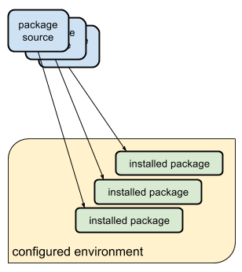
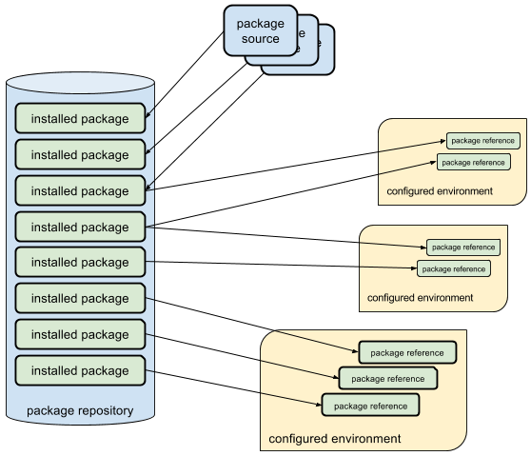

Typical package managers install packages into an environment
Rez installs packages once, and configures environments dynamically
Joined ASWF in February 2022.
Developed by Allan Johns of Method Studios.
Cross-platform package manager that leverages a central repository for storing packages instead of installing into each environment separately, reducing the time to create complex environments to just a few seconds.
Key contributors include Luma Pictures, Method Studios, NVIDIA, and Shotgrid
github.com/nerdvegas/rez

Slide 27


Formed as a working group in late 2020, and became an ASWF project in January 2022.
Provides a library of exemplar, production grade assets for use in testing and research.
All assets are made available under the ASWF Digital Assets License, which was created specifically with the needs of the industry in mind.
Key contributors include Animal Logic, ASC, and Intel
gerrit.aswf.io/r/asset

Slide 28
Joined ASWF in January 2021.
Software package that converts digital camera raw files to ACES container files containing image data encoded according to the Academy Color Encoding Specification (ACES) as specified in SMPTE 2065-1.
Key contributors include AMPAS and Weta Digital
github.com/AcademySoftwareFoundation/rawtoaces

Slide 29
Working Groups
CI
Diversity and Inclusion
Review & Approval
Rust
USD

Slide 30
How to contribute
Contribute to an existing project:
Submit a PR with a bugfix or new feature
Pick existing GitHub issue as a sample project
Integrate with a new app / contribute plugin
Help improve project documentation
Submit additional test cases
Join the TSC discussion: dev mailing list, conf calls
Get involved with the TAC or Working Group:
DevOps / CI expertise always useful
Interest / expertise in security especially welcome
Join the TAC discussions: mailing list, conf calls, working groups

Slide 31
Join the Discussion
Mailing Lists for ASWF projects: lists.aswf.io
Join as a member: aswf.io/join
Slack: slack.aswf.io
Github: github.com/AcademySoftwareFoundation
Behind the Screens: bit.ly/BehindtheScreens
Twitter: @AcademySWF, #ASWF
YouTube: AcademySoftwareFoundation

Slide 32
How to participate
Developers can join our mailing lists to stay informed
about the code and our projects at lists.aswf.io.
Learn how your organization can support the Academy Software Foundation community at aswf.io/join.
Stay connected to us on Twitter at
@AcademySWF and #ASWF

Slide 33


